Slide 1

A NEW STANDARD FOR AIRPORT HOTELS
SCANDIC FLESLAND AIRPORT
scandichotels.com/fleslandairport

Slide 2
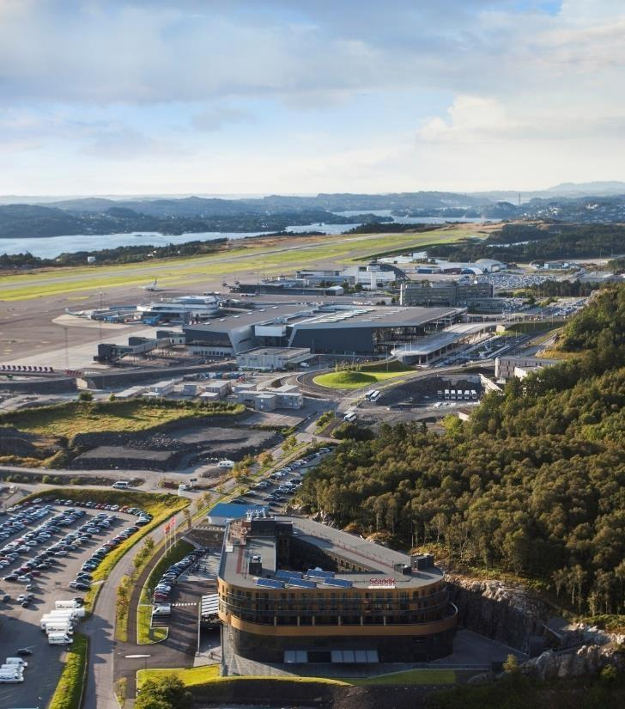
CENTRALLY LOCATED AT FLESLAND
On April 3, 2017 we opened the doors to western Norway’s largest congress hotel, Scandic Flesland Airport. The hotel is centrally located at Bergen Airport, within walking distance
of the new airport terminal and Bybanen.
We have plenty of parking for our guests arriving by car,
and offer a free shuttle bus to and from the airport.
Photo: Varde/Avinor

Slide 3
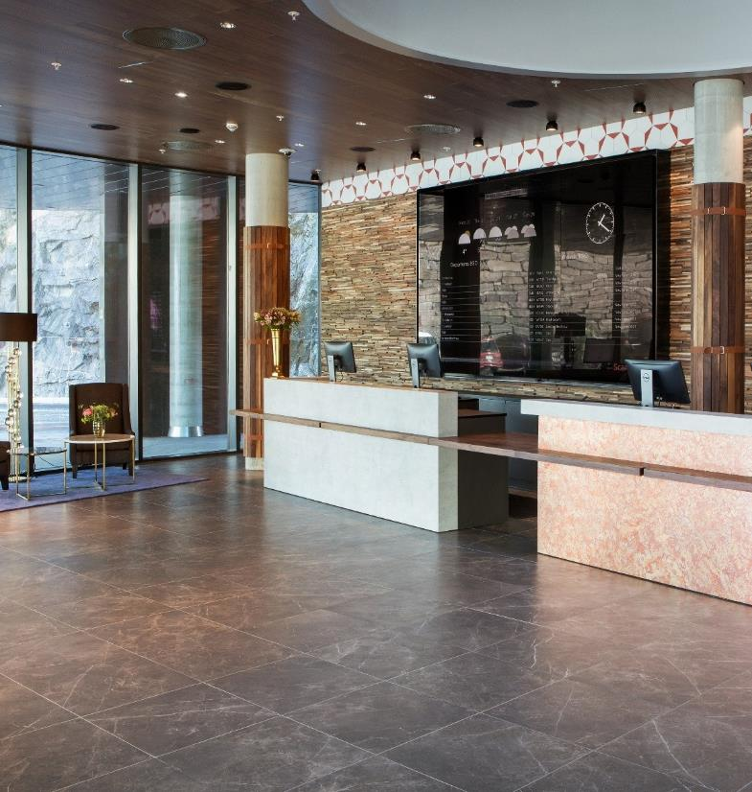
SHORT ABOUT US
Year of construction
2017
Ecolabelling
The Swan ecolabel
Rooms
Total 300 rooms, all 300 non-smoking
Suites: 6
Accessibility rooms: 33
Connecting rooms: 8
Location
Distance to Bergen Airport: 500 m
Distance to Bybanen: 500 m
Distance to shuttle bus: 0 m
Distance to Bergen city centre: 15 km
Meeting rooms
25 small, medium and large meeting rooms
Maximum meeting capacity in theater style: 1000
Banquet capacity: 850
Other facilities
Italian restaurant, Popolo Osteria & Bar
24/7 lobby shop
Roof terrace
Garden
Gym and sauna
Outdoor amfi
Outdoor parking and garage in basement (for a fee)

Slide 4
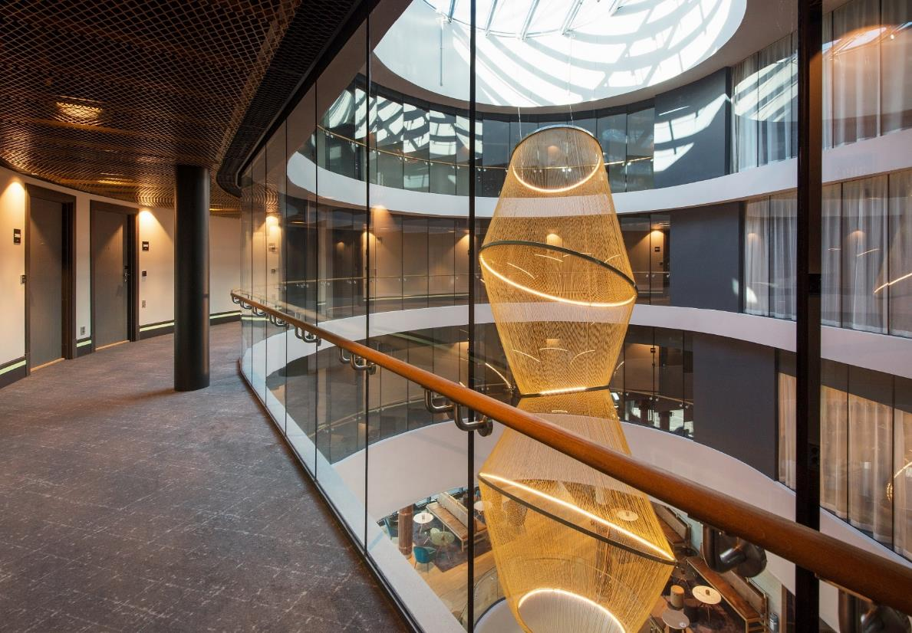

Slide 5
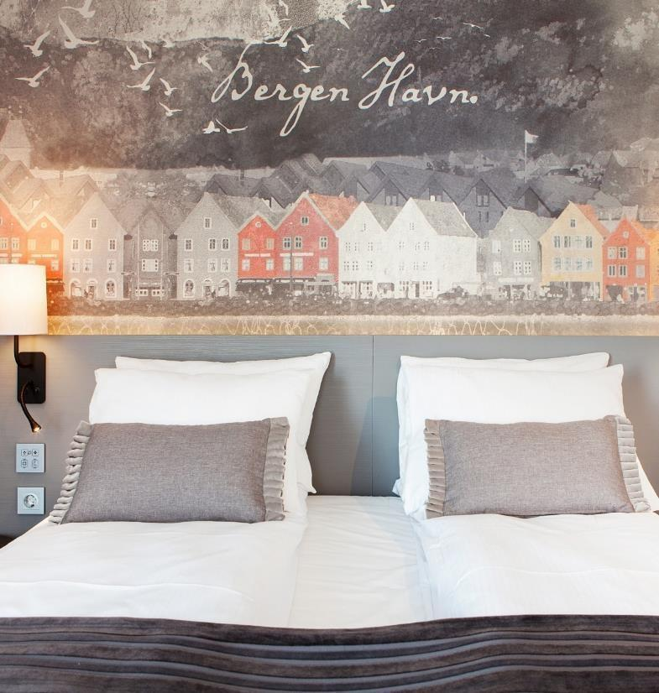
ROOMS
FOR ALL
Scandic Flesland Airport offers over 900 beds in 300 modern and comfortable rooms, including 6 large suites. All rooms have daylight and windows with the possibility of airing.
Several rooms are designed with extra thought and smart design. They are our accessible rooms and family rooms – perfect for sports teams, organizations or large families.

Slide 6
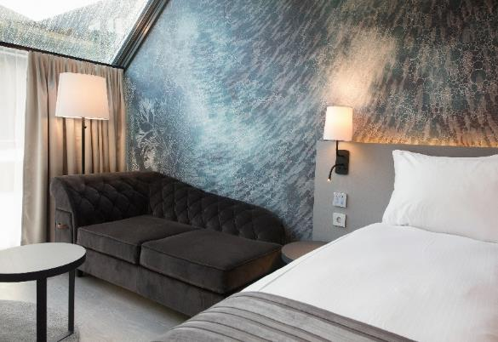
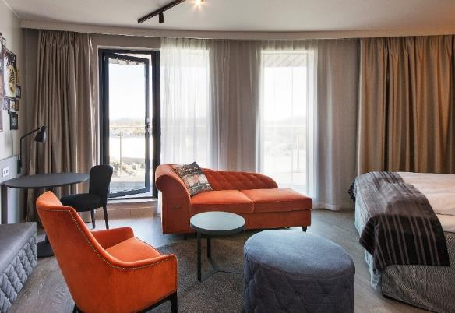
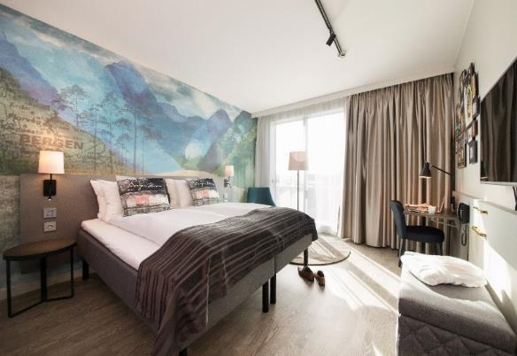
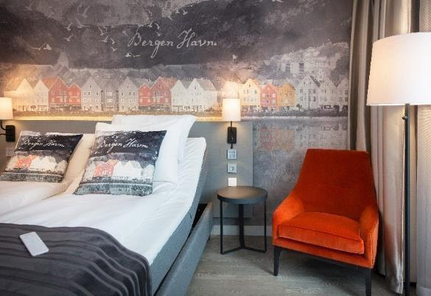

Slide 7
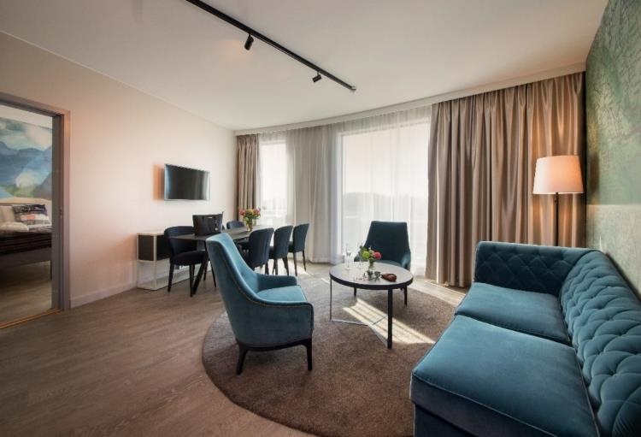
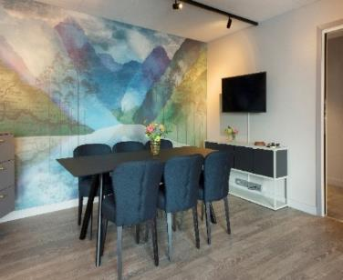
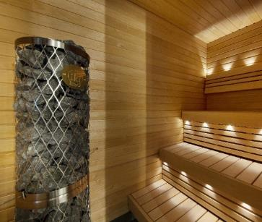
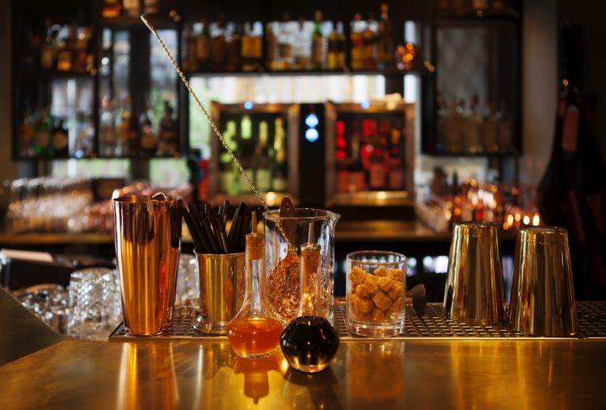
OUR SUITES
Our most exclusive rooms offer large space and separate bedroom and living room with a nice view.
All rooms come with both a bathtub and a shower.
Lower your shoulders and relax in our master
suites.
If you wish to work or have a small meeting, these rooms have their own conference table and coffee/tea making facilities.

Slide 8
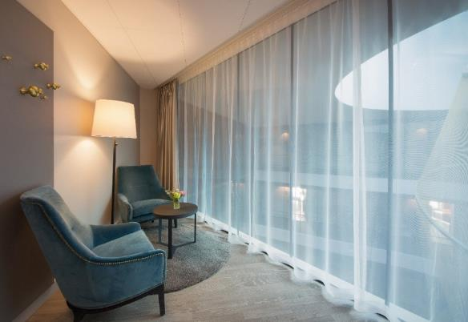
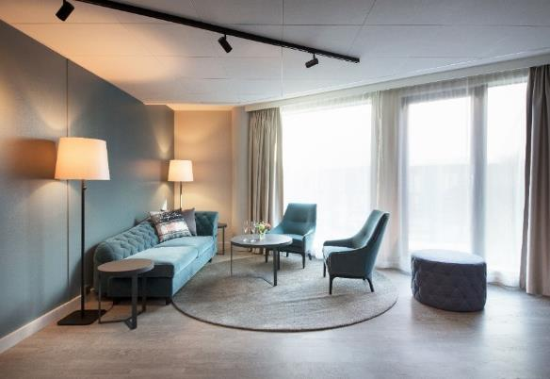
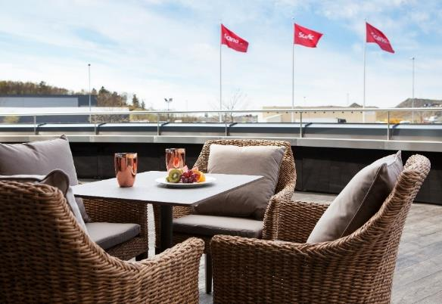
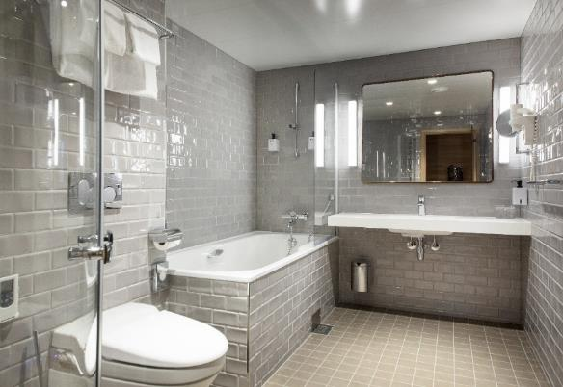

Slide 9
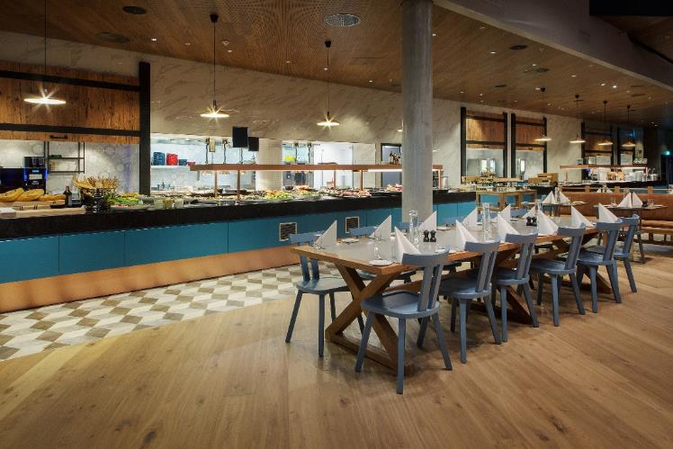
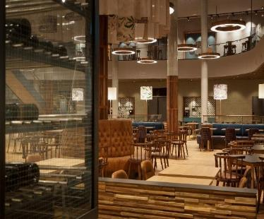
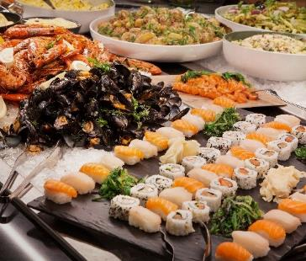


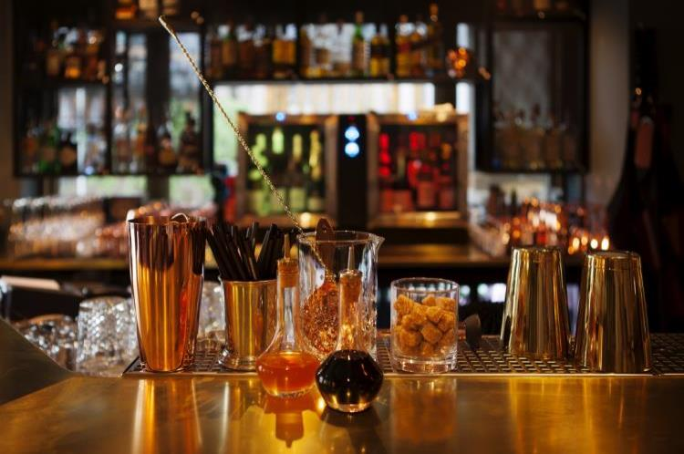
FOOD & DRINKS
Our large main level restaurant, Flight Mode, is used by both hotel and meeting guests. This is where we serve our meeting buffets – and of course Scandic's award-winning breakfast with a wide range of organic products.
We set a new standard for early bird breakfast and offer
a tasty and rich breakfast buffet, including a breakfast chef serving eggs and omelets as you desire. And because we know that sometimes you have to catch an early flight, we already offer it from 04:00.
For those in a hurry, we offer Grab & Go! Handy breakfast items that you can eat and drink on the go.

Slide 10
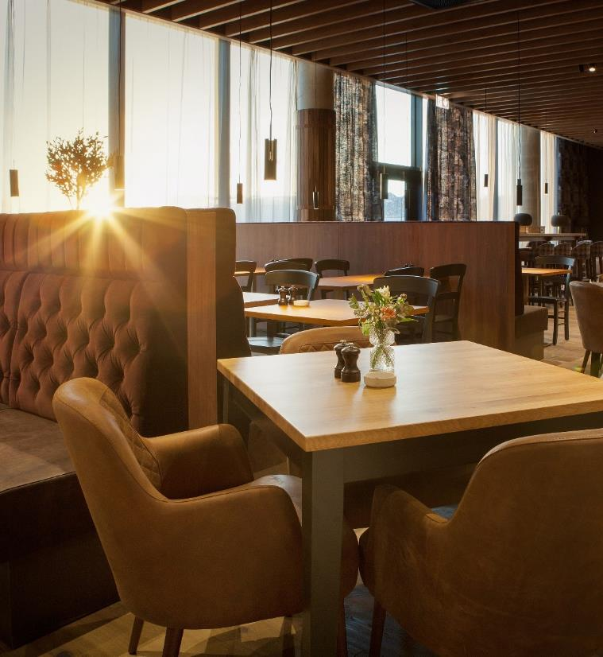

POPOLO OSTERIA & BAR
Piazza del Popolo, “People’s place”, is a bustling square in the center of Rome. In the same way, Popolo restaurant is a vibrant meeting place at Scandic Flesland Airport, and a place where Italian food and drinks make the backdrop for both small and big occasions.
Start your work day or travel with our tasty lunch dishes. Or can we tempt you with a full Italian dinner where well known and less famous specialties are served along with wines from our extensive drink menu?
Fresh ingredients, curiosity and passion for Italian cuisine are our driving force – and we welcome you on board our Italian travel!

Slide 11
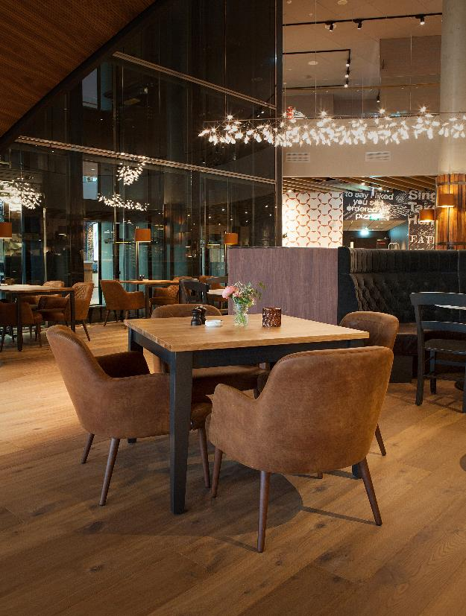
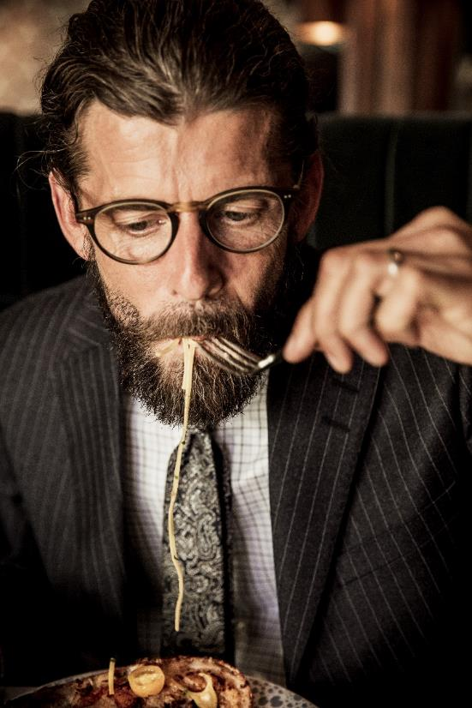
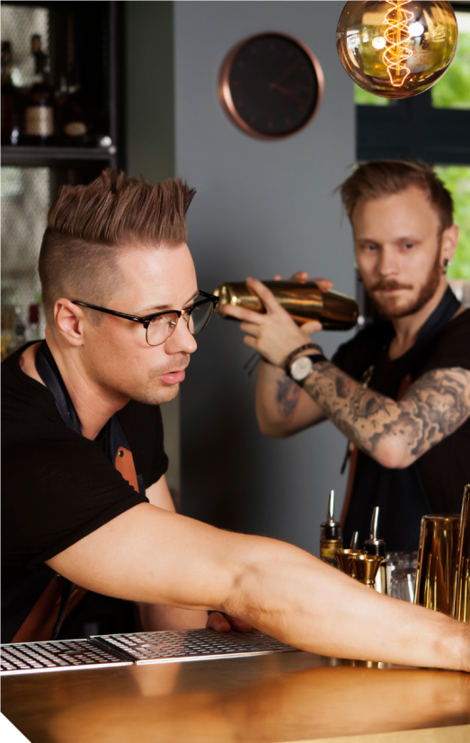

Slide 12
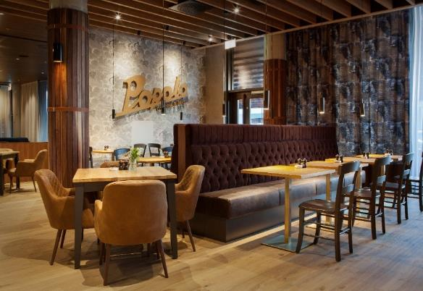
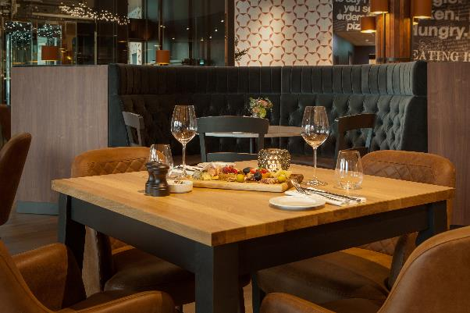
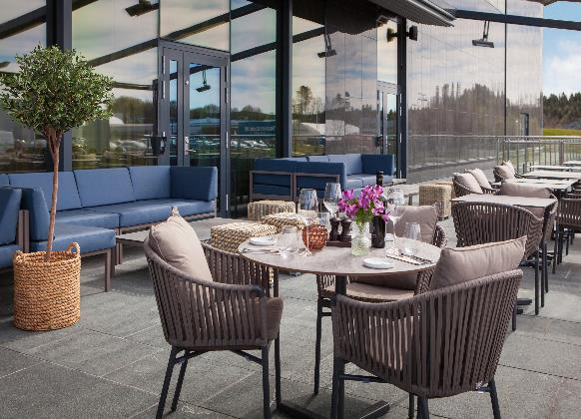
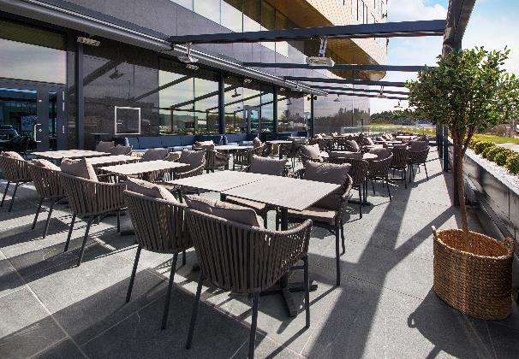
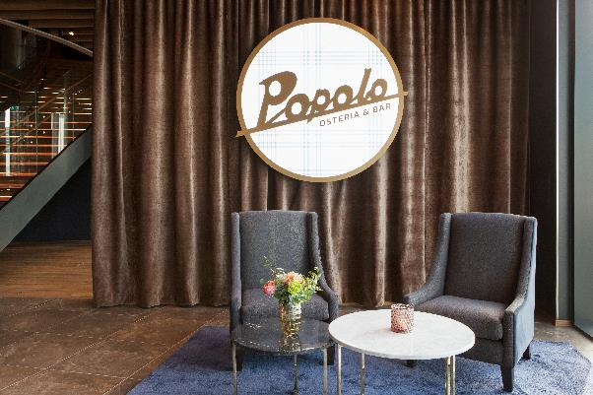

Slide 13
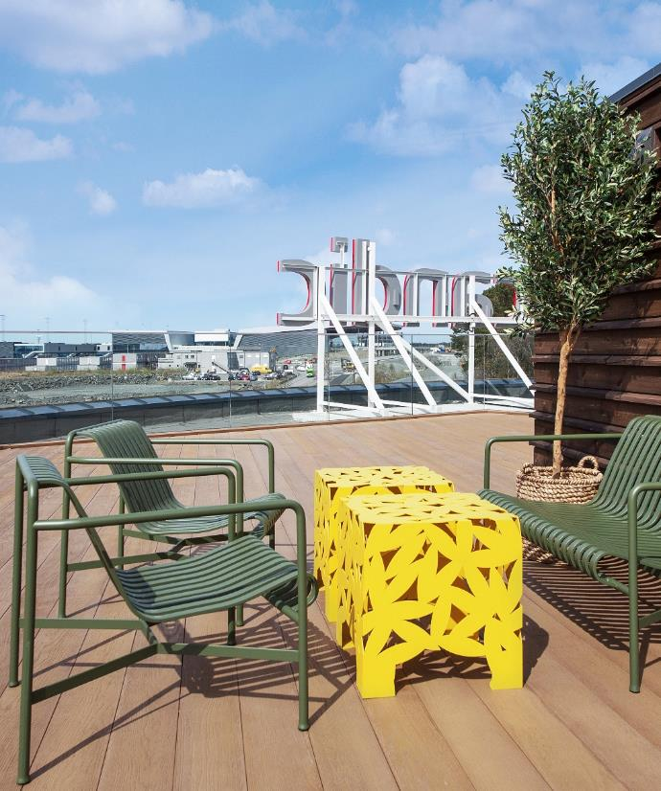
IT’S EASY TO MEET AT FLESLAND
At Scandic Flesland Airport we can host both small day meetings and major congresses for up to 1,800 people. On sunny days you can hold your gathering in our outdoor areas that are facilitated for exhibitions and events. Including our large roof terrace overlooking the sea and the runway.
For meeting attendants, we are only 300 meters from the new airport terminal. If they come by car, we offer parking opportunities both indoors and outdoors in our 4000 m2 basement garage.

Slide 14
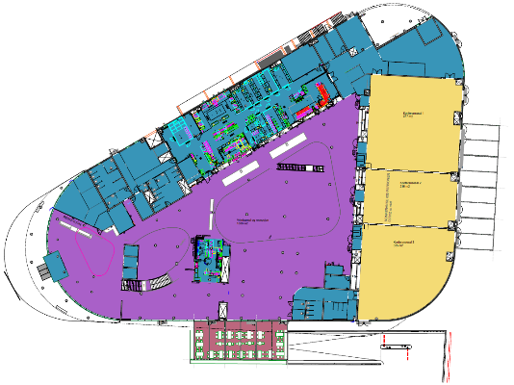
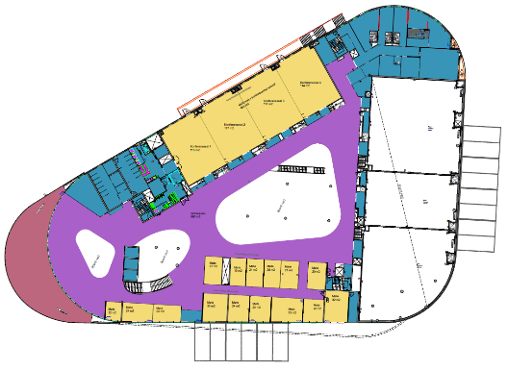
MAIN LEVEL
FLOOR 1
Entrance and reception
Italian restaurant, Popolo Osteria & Bar
Breakfast/lunch/dinner restaurant
Great hall of 928 m2 with max. capacity of 1000 persons.
Can be divided. Top modern AV equipment.
Mingling and exhibition area
4000 m2 garage in basement, suitable as exhibition area
FLOOR 2
Mingling and exhibition area
17 small meeting rooms
Terrace
Great hall of 461 m2 with max. capacity of 512 persons.
Can be divided. Top modern AV equipment.
Exclusive suite with own access to meeting room

Slide 15
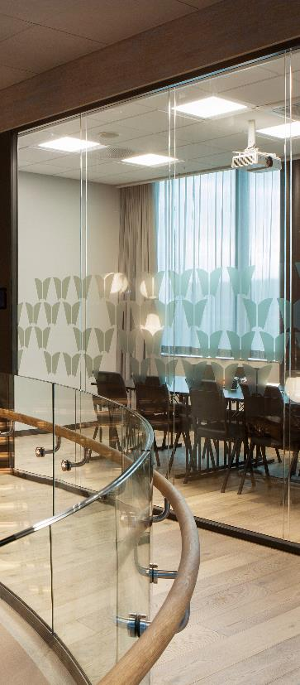
NAME
DAYLIGHT
M2
BOARD ROOM
SCHOOL
THEATER
U TABLE
BANQUET
The Golden Circle
Yes
928
750
1000
850
The
Yes
377
242
338
290
Golden
Yes
216
144
256
180
Circle
Yes
335
200
324
270
Fly Away With
Us
Yes
461
400
512
320
Fly
Yes
115
84
100
50
80
Away
Yes
117
84
100
50
80
With
Yes
117
84
100
50
80
Us
Yes
114
84
100
50
80
Gate 1
Yes
12
6
Gate 2
Yes
24
12
16
20
Gate 3
Yes
20
12
16
20
Gate 4
Yes
30
10
18
24
10
10
Gate 5
Yes
24
10
12
16
10
10
Gate 6 / Gate
5+6
Yes
23 /
47
10 /
24
12 /
26
16 /
32
10
10
Gate 7
Yes
33
16
24
28
Gate 8 / Gate
7+8
Yes
20 /
53
8 /
32
12 /
32
12 /
38
10
10
Gate 9
Yes
32
14
24
28
14
14
Gate 10
No
21
12
12
16
Gate 11
No
19
12
12
16
Gate 12
No
21
12
12
16
Gate 13 / Gate
11+12+13
No
20 /
59
12 /
36
12 /
36
16 /
48
Gate 14
No
21
10
Gate 15
No
20
10
Green Room
Yes
51
16 (+4)
40
48
Brief room
No
16
8
Roof terrace – Take Off
No
300
Overlooking the runway and the sea. Possibilities for barbeque and a bar
Outdoor Amfi
Yes
300
Outdoor area with roof and amfi
Garage
No
4500
Indoor dry basement. Suitable for exhibitions and fairs
Minglesvingen
Yes
200
Lounge and mingling area
Popolo Osteria & Bar
Yes
Italian restaurant
Flight Mode
Yes
200
Breakfast & lunch restaurant

Slide 16
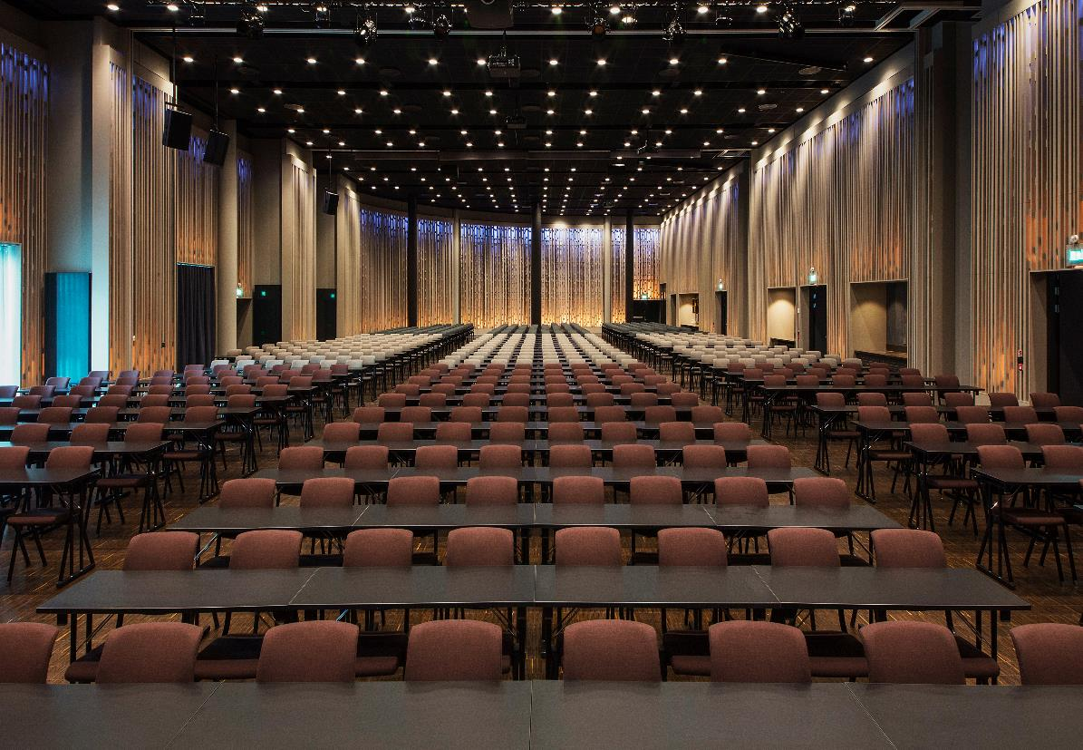
THE GOLDEN CIRCLE

Slide 17
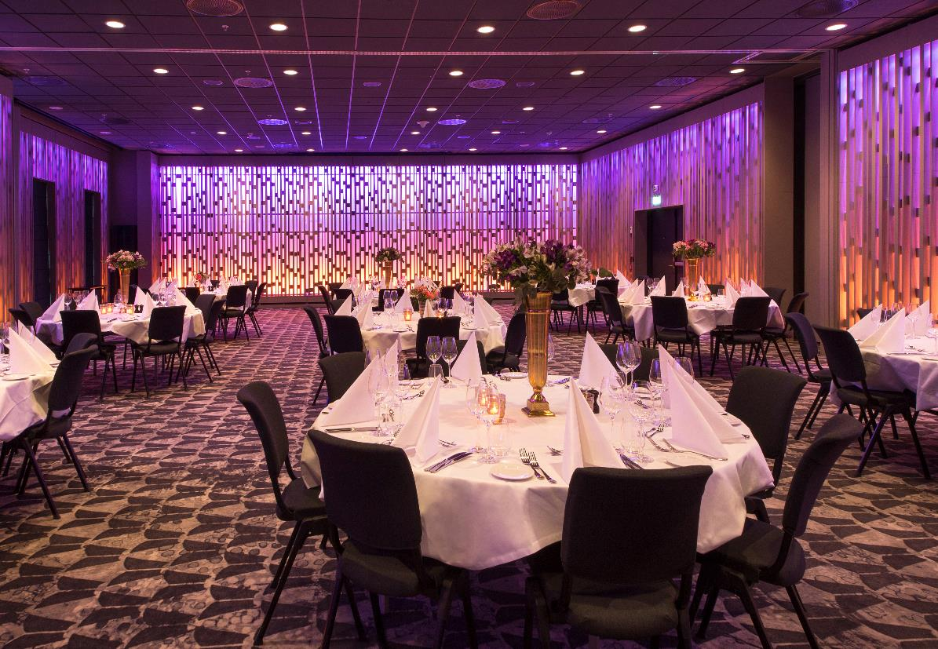
FLY AWAY WITH US
BANQUET STYLE

Slide 18
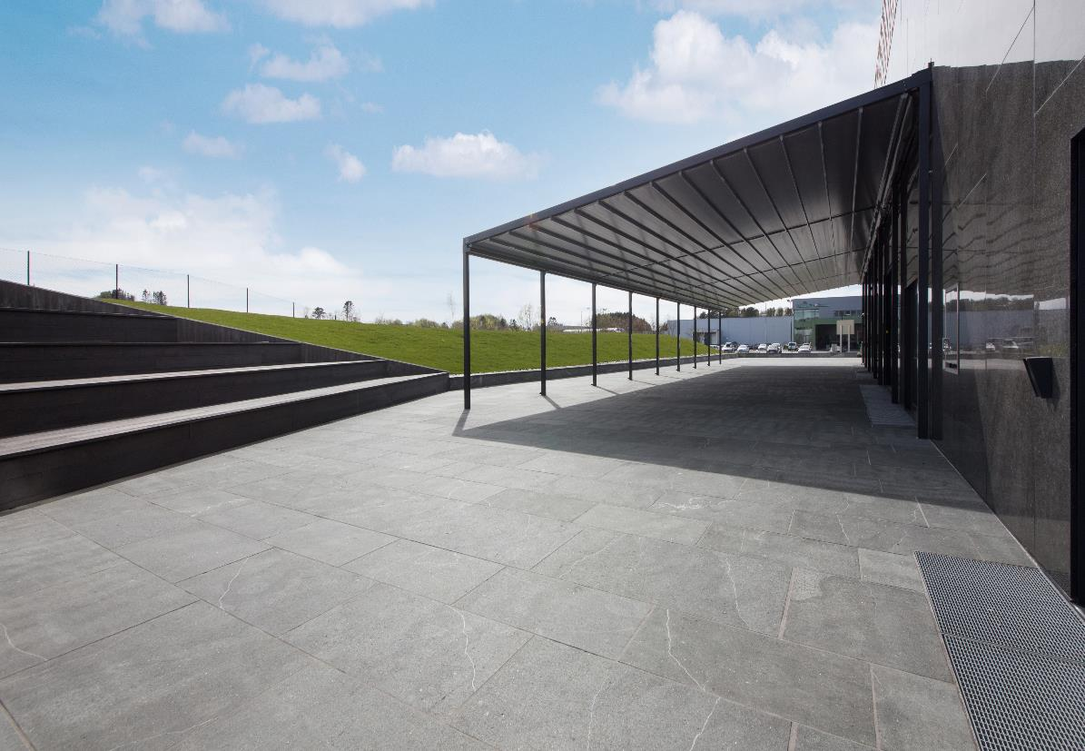
THE GOLDEN CIRCLE
AMFI

Slide 19
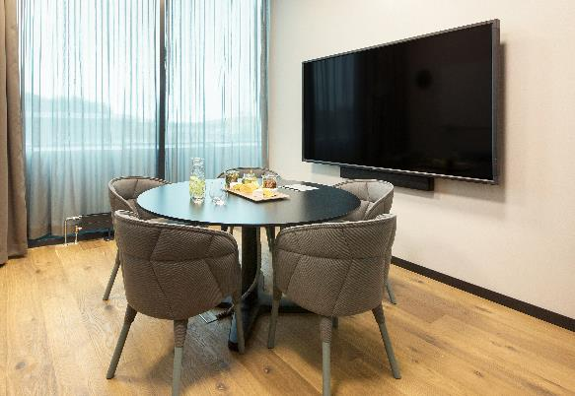
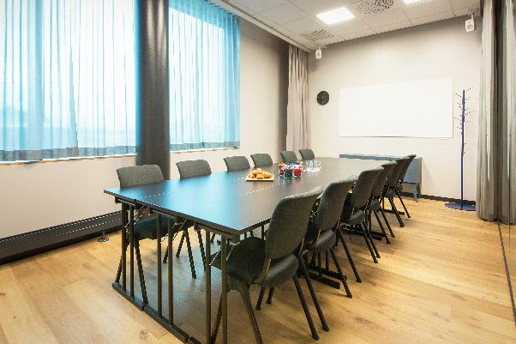
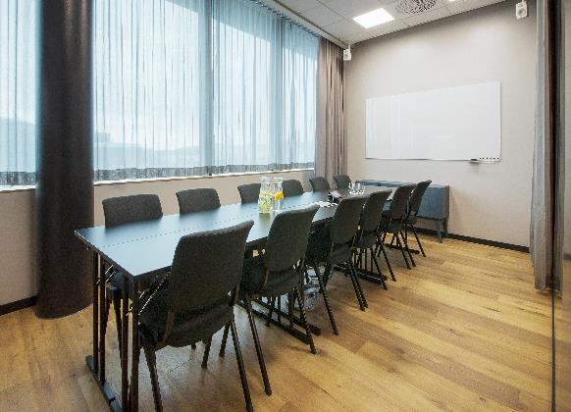
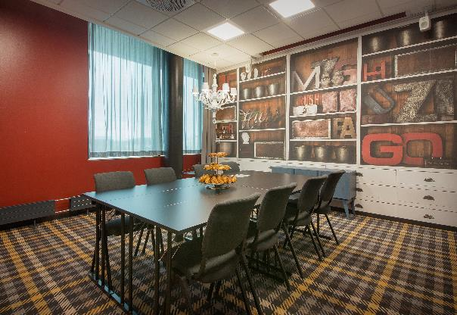
GATE 1
GATE 2
GATE 3
GATE 4

Slide 20
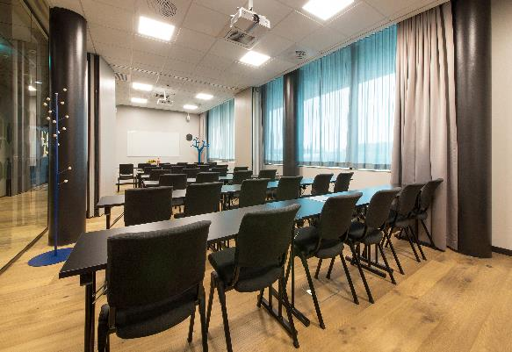
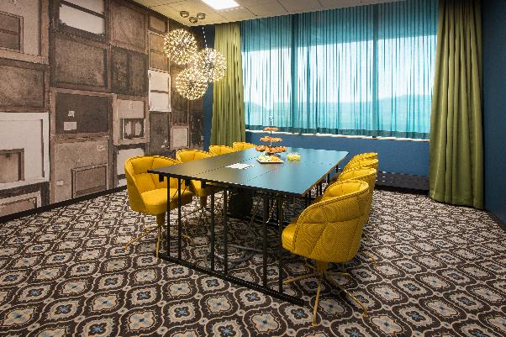
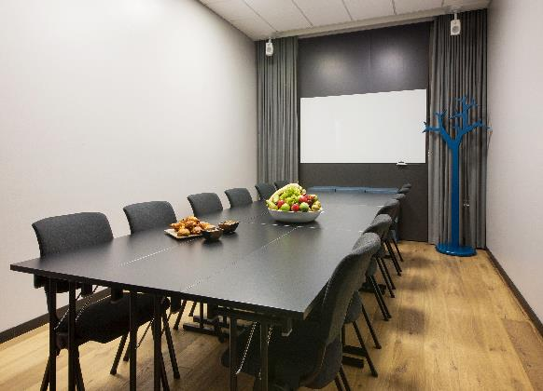
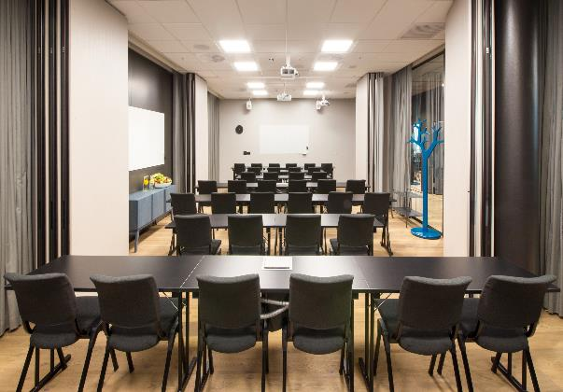
GATE 5+6
GATE 9
GATE 10
GATE 11–13

Slide 21
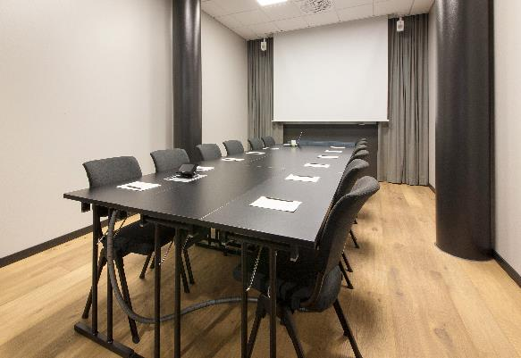
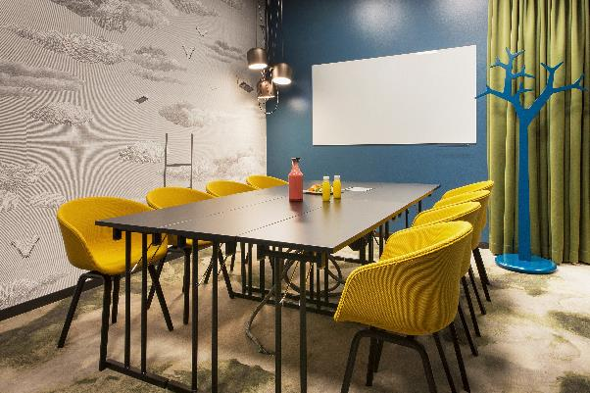
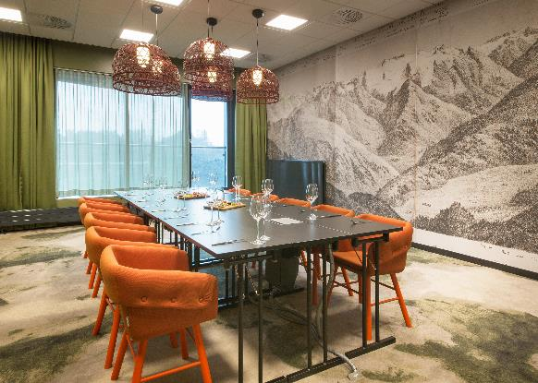
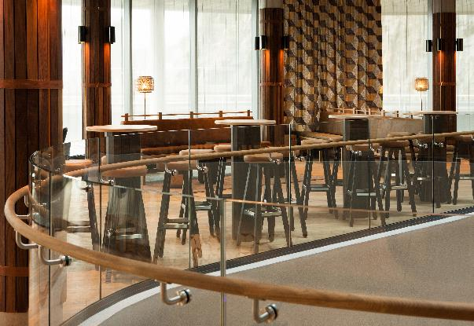
GATE 14
GATE 15
GREEN ROOM
MINGLESVINGEN

Slide 22
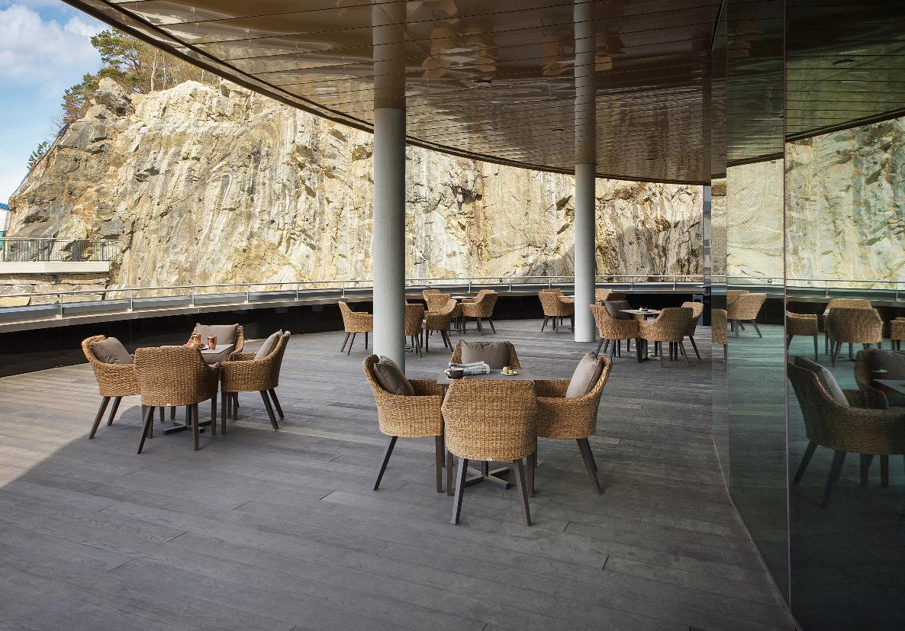
MINGLESVINGEN
TERRACE

Slide 23
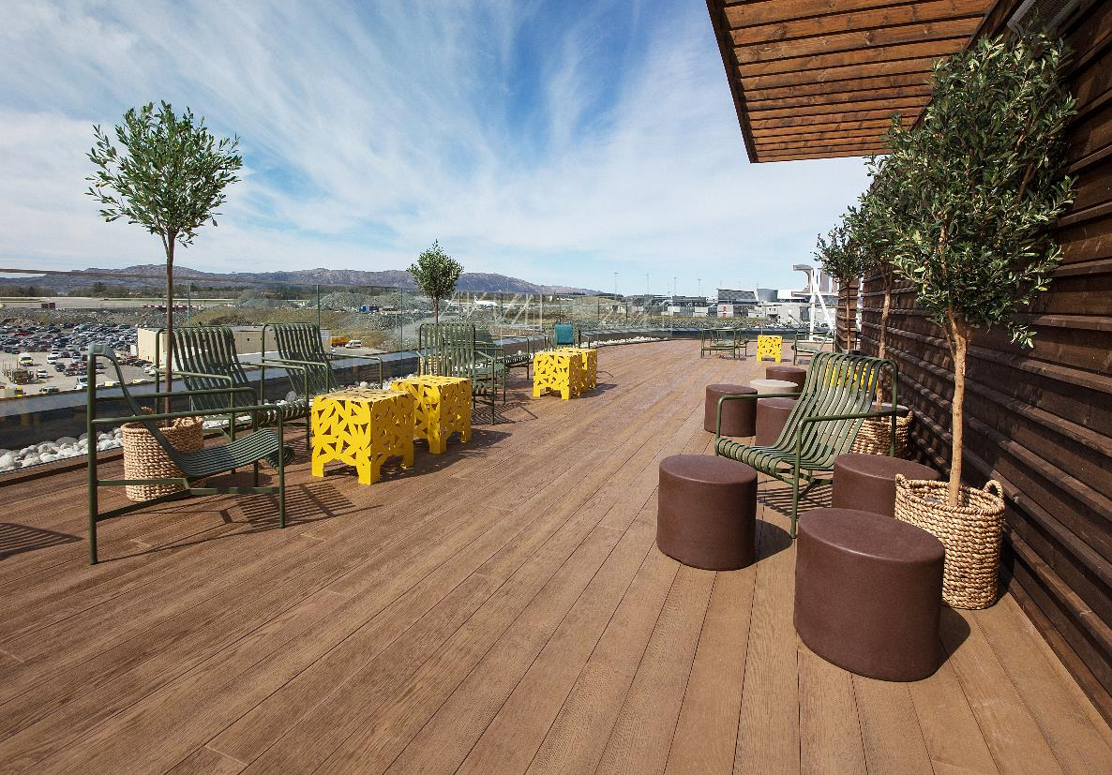
ROOF TERRACE
TAKE OFF

Slide 24

GARDEN
GYM

Slide 25
WELCOME!
Scandic Flesland Airport | Lønningsvegen 9, 5258 Blomsterdalen
Tel. +47 55 14 03 00 | E-mail: fleslandairport@scandichotels.com

